Slide 1





AtliQ Hardware
Consumer Goods
Ad – hoc Insights
SQL Project
Presented by : Sachin Savkare

Slide 2


About AtliQ Hardware (Imaginary company)
One of India’s top computer hardware manufacturers
Rapidly expanding across international markets
Business Insight Gap
Leadership identified a lack of timely, data-driven insights
Slower decision-making impacting strategic actions
Need for Talent
Growing demand for actionable insights led to a plan to strengthen the analytics team
Focus on hiring junior data analysts with strong technical and analytical thinking skills
Challenge Overview
SQL-based assessment designed by Data Analytics Director Tony Sharma
Includes 10 ad hoc business requests simulating real-world scenarios
Aims to evaluate SQL expertise, problem-solving, and communication abilities
Bridging the Insight Gap at AtliQ Hardware.

Slide 3
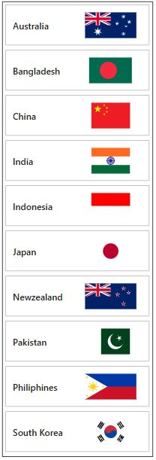
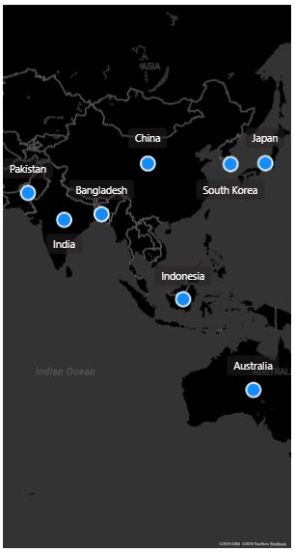
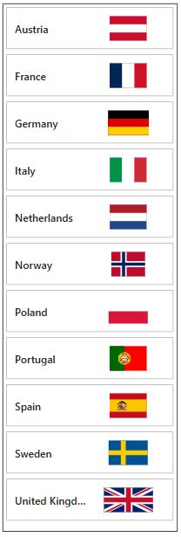
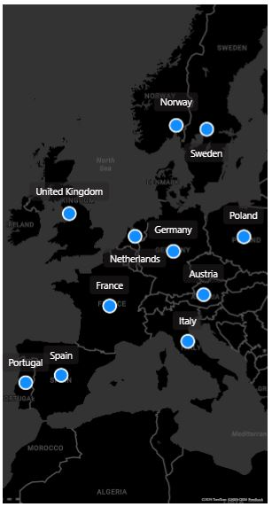
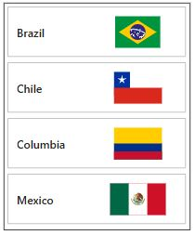
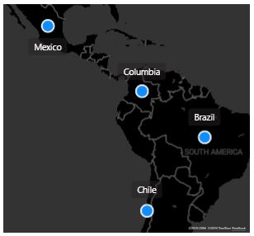
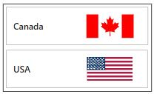
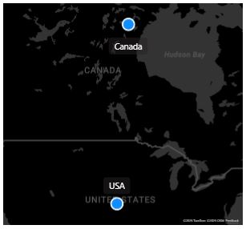
APAC Region & Market
EU Region & Market
LATAM Region & Market
NA Region & Market
AtliQ`s Position in the Market

Slide 4
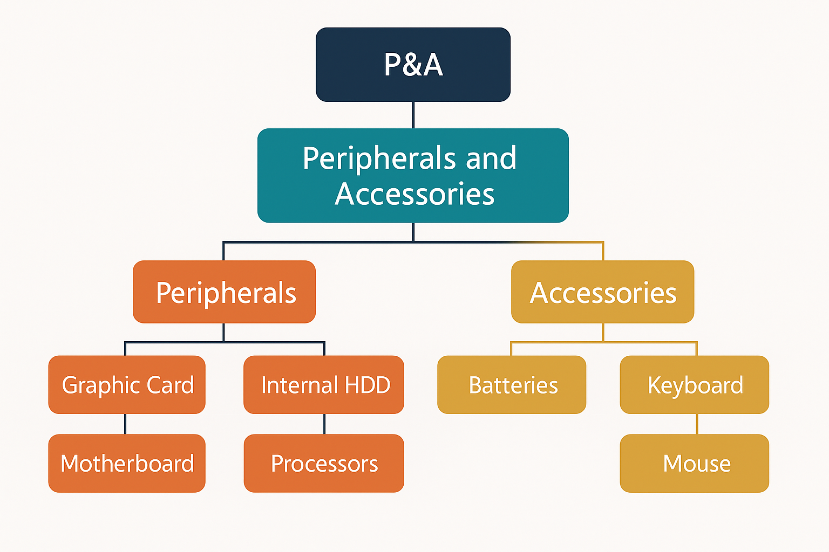
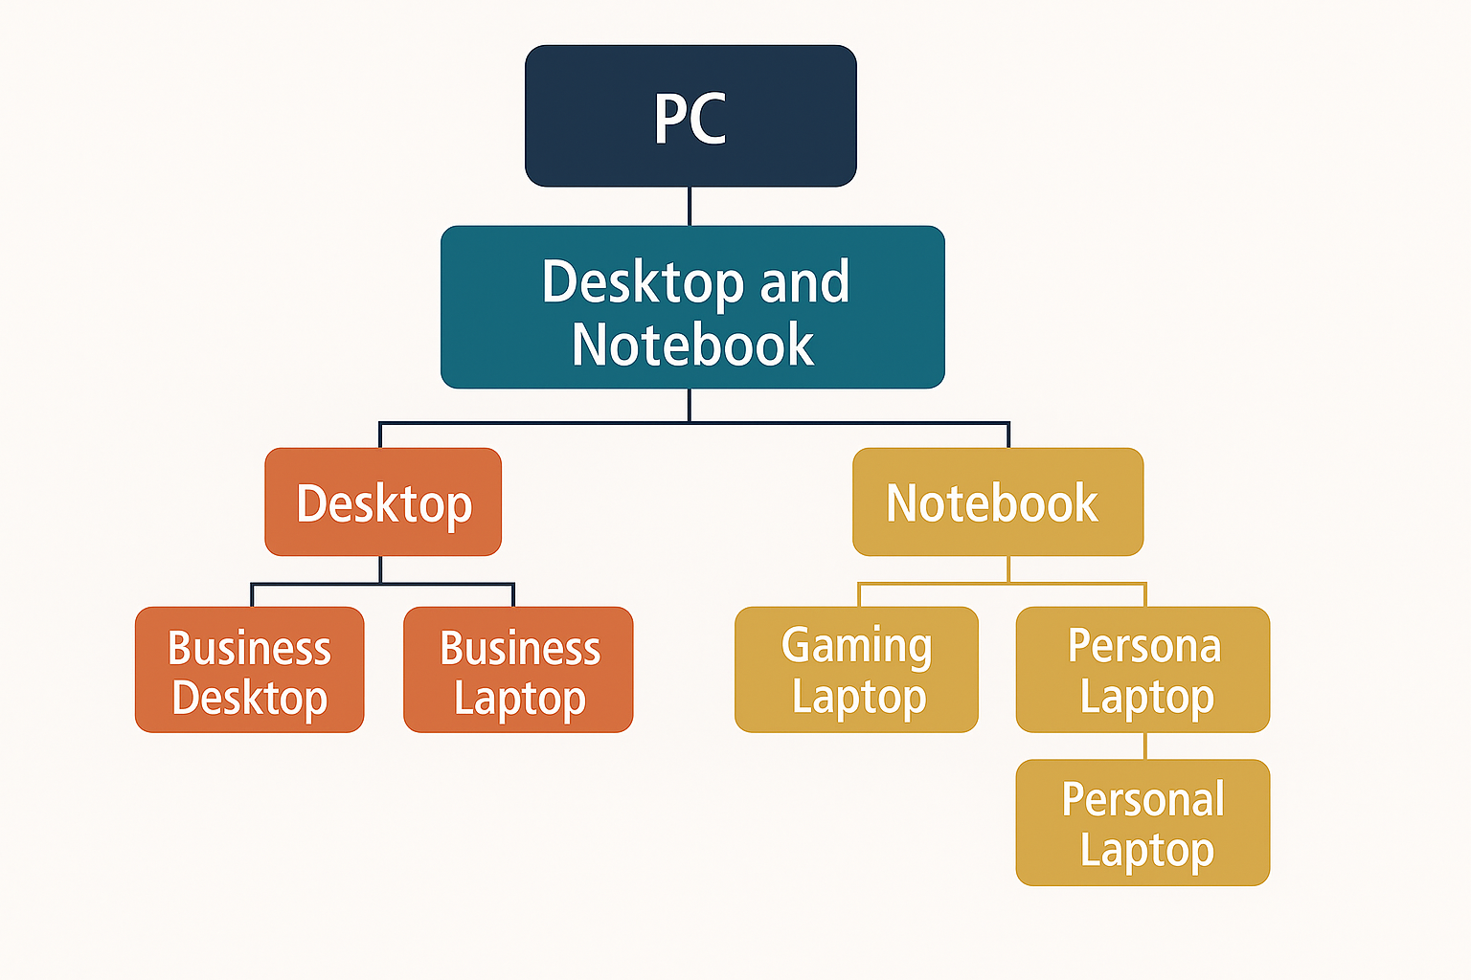
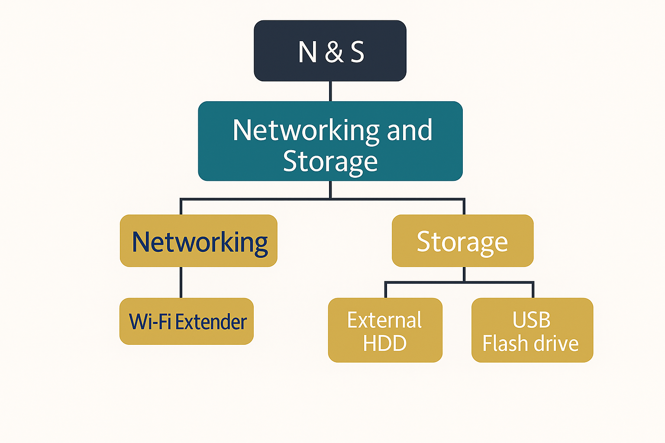
AtliQ`s has many products to serve different customers.

Slide 5
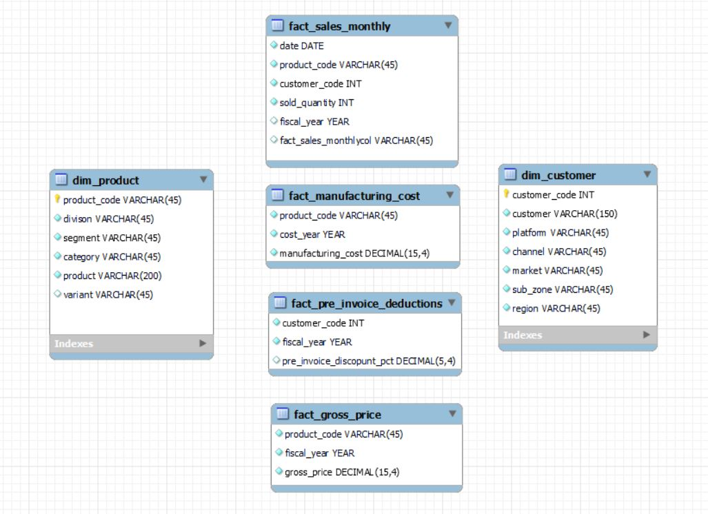
The input data includes sales data for FY 2020 and FY 2021, along with dimension tables such as customer and product details. The ER diagram shows fact tables like
sales,
manufacturing cost,
Pre invoice deductions, and
gross price.
FISCAL YEAR
SEPTEMBER 2019 – AUGUST 2020 (FY 2020)
SEPTEMBER 2020 – AUGUST 2021 (FY 2021)
Exploring the Input Data of AtliQ Business

Slide 6
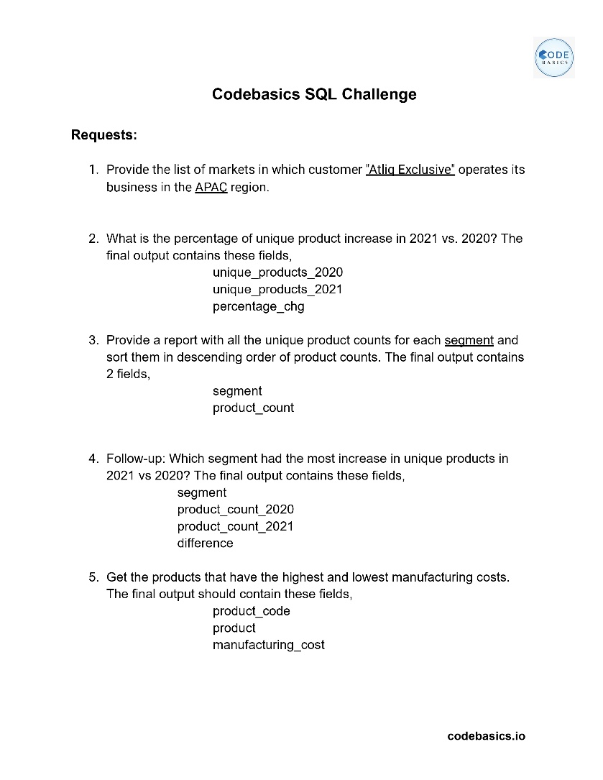
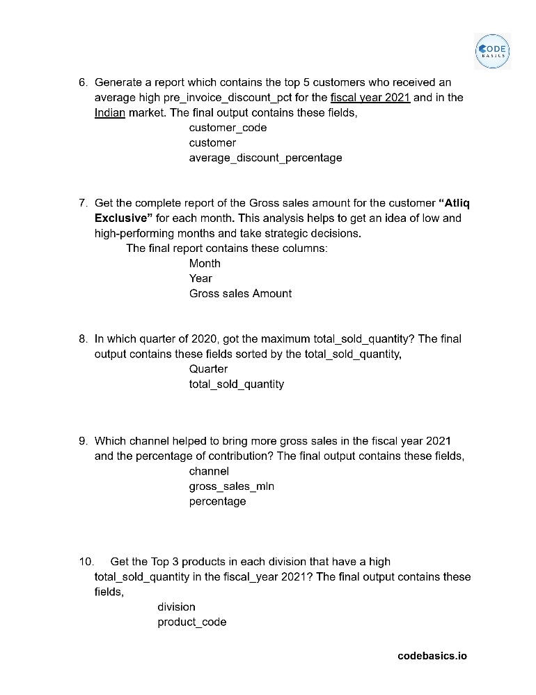
Analysis of Ad-Hoc Requests: SQL Query Results, Strategic Insights, and Data Visualizations

Slide 7
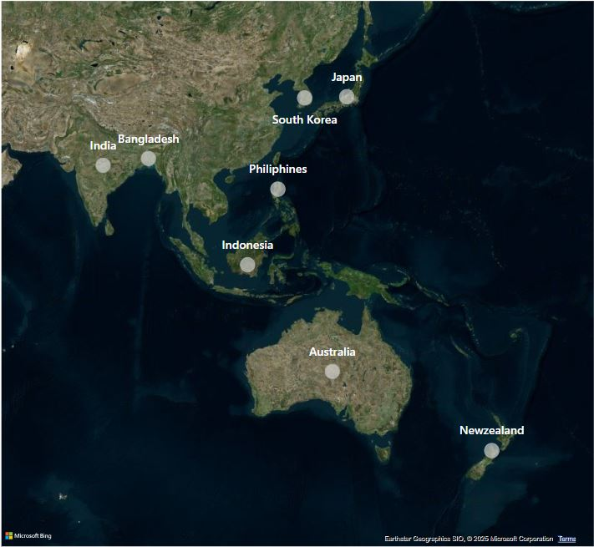
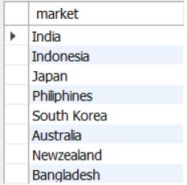

SQL Result Grid
Markets where “Atliq Exclusive” operates in APAC
Business Question: 1
Provide the list of markets in which customer “Atliq Exclusive" operates its business in the APAC region.

Slide 8
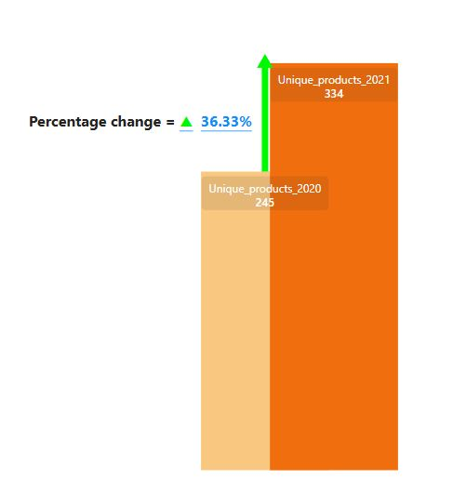
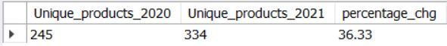
SQL Result Grid
Percentage Increase of Unique Products in 2021 vs 2020
Business Question: 2
What is the Percentage of Unique Products increase in 2021 vs 2020 ? The Final Output contain these field : Unique_products_2020, Unique_products_2021, percentage _chg
Unique Products 2021 vs Unique Products 2020
Insights :
As observed, the number of unique products increased from 245 in 2020 to 334 in 2021, marking a significant growth of approximately 36.33%.
Rising market demand : Encourage higher production levels.
It’s a positive sign that company innovating and expanding its product portfolio, staying competitive and responsive to market trends.

Slide 9
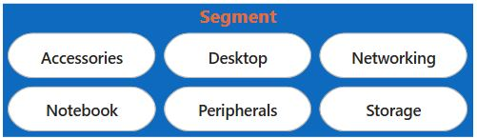
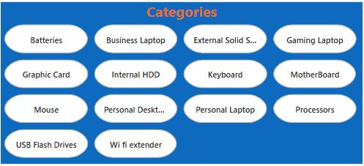


Possible Reasons:
Surge in consumer demand
Entry into new markets/categories
Launch of seasonal/promotional products
Strategy to diversify offerings and reduce product dependency
Suggestions:
Identify top-performing new products
Evaluate profitability vs. volume for sustainable growth
Use customer feedback and market trends to guide future launches
Ensure supply chain flexibility to support growing SKU base

Slide 10
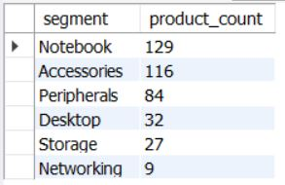
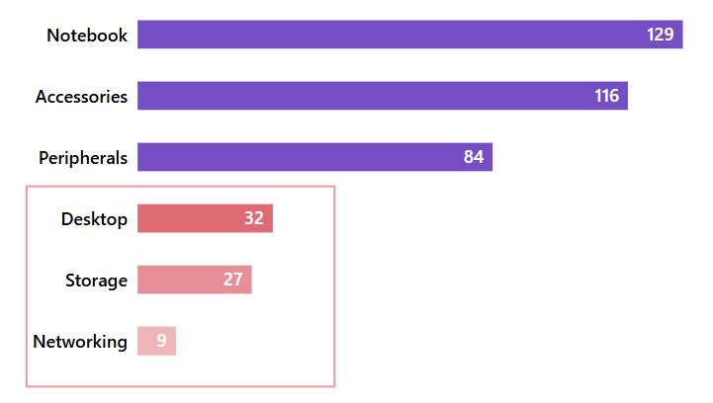
SQL Result Grid
Unique Product Counts by Segment
Business Question: 3
Provide a report with all the unique product counts for each segment and sort them in descending order of product counts. The final output contains 2 fields, segment and product_count
Unique Product Counts for each Segment
Insight
Notebook (129), Accessories (116), and Peripherals (84) make up 83% of total products.
Desktop (32), Storage (27), and Networking (9) are underrepresented, but show higher Avg. Gross Sales, especially:
Networking: 5,207.13
Storage: 3,102.33
Desktop has the lowest GM% (69.92%), affecting overall profitability.
Indicates strong focus on high-volume segments, but high-value potential exists in low-volume segments.

Slide 11
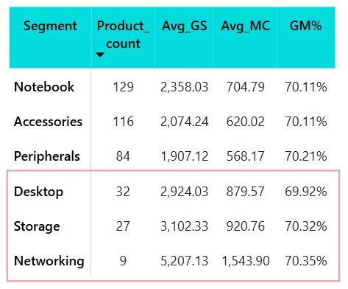
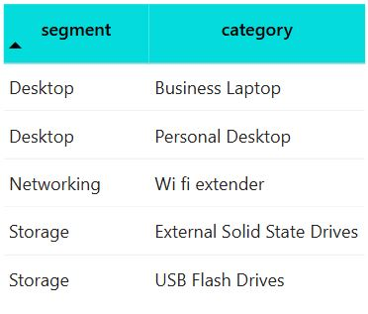
Possible Reasons
Established demand in top 3 segments.
High-value, niche products in Networking and Storage.
Fewer product categories in low-volume segments (only 2 per segment).
Desktop's lower margins may be limiting production interest.
Recommendations
Expand category variety in Storage, Networking, and Desktop.
Leverage high-performing categories like Wi-Fi Extenders and SSDs.
Improve profitability in Desktop by optimizing pricing or sourcing.
Balance product strategy between volume growth and value-driven segments.

Slide 12
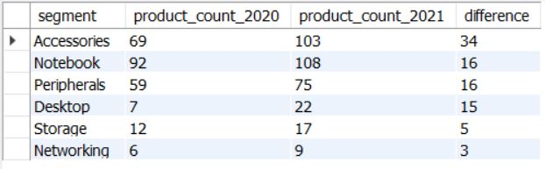
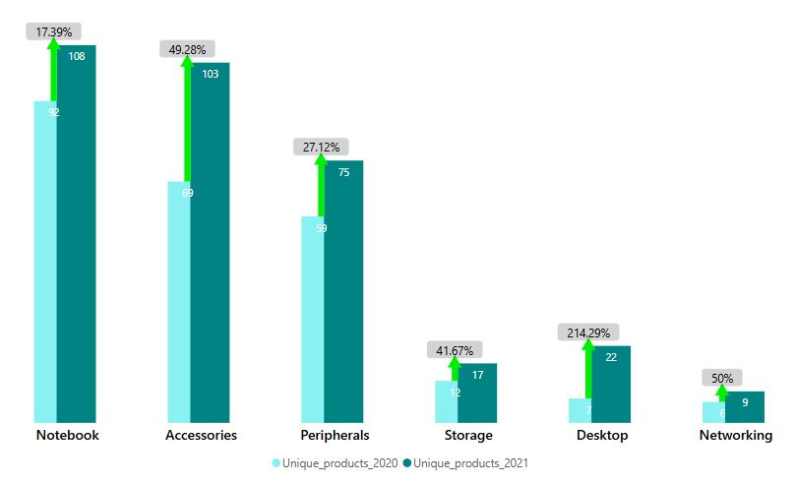
SQL Result Grid
Segment with Highest Increase in Unique Products (2021 vs 2020)
Business Question: 4
Provide a report with all the unique segment which had the most increase in unique products in 2021 compared to 2020? Output fields: Segment, Product_count_2020 Product_count_2021, Difference
Insight
Accessories had the highest growth: +34 products (49.28% increase) from 2020 to 2021.
Strategic focus in 2021 was on diversifying the Accessories segment.
Notebook (+16 products, 17.39%) and Peripherals (+16 products, 27.12%) also showed steady growth.
Desktop saw a 214.29% jump (from 7 to 22 products), indicating revived interest despite small base.
Storage (+5 products, 41.67%) and Networking (+3 products, 50%) grew slower in absolute terms.
Unique Product Counts for each Segment

Slide 13
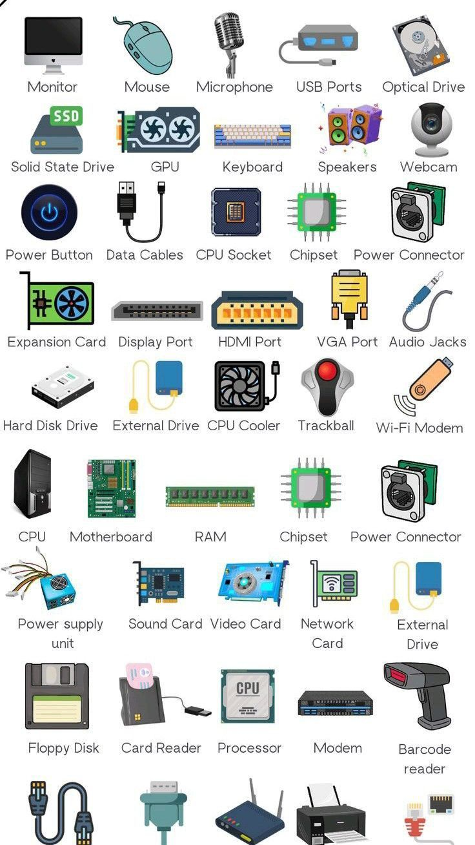

Possible Reasons
High market demand and broader use cases in the Accessories segment.
Company strategy focused on expanding variety and addressing consumer trends.
Desktop’s rise may result from renewed positioning or updated product line.
Limited R&D or supply chain focus on Storage and Networking segments.
Recommendations
Sustain momentum in Accessories, Notebooks, and Peripherals through continuous innovation.
Evaluate potential in Storage and Networking with market research and demand forecasting.
Scale up Desktop offerings to build on recent growth and expand presence.
Ensure balanced growth strategy to prevent overdependence on high-volume segments.
Consumer Trend

Slide 14

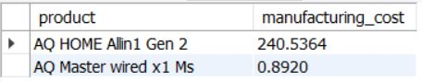
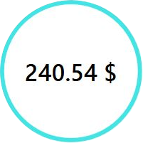

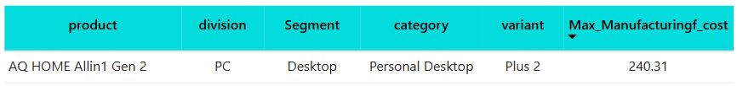
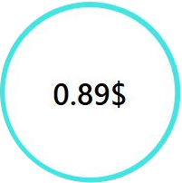
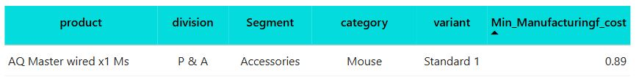
SQL Result Grid
Products with Highest and Lowest Manufacturing Costs
Business Question: 5
Get the products that have the highest and lowest manufacturing costs.
Output fields: Product_code, Product, Manufacturing_cost
Which product in our portfolio incurs the least manufacturing cost?
Which product in our portfolio incurs the highest manufacturing cost?

Slide 15
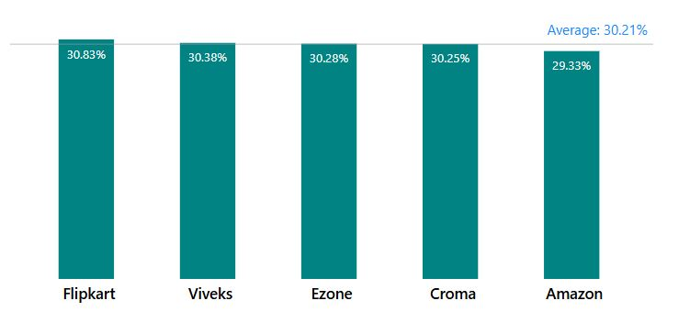
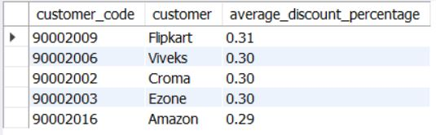
SQL Result Grid
Top 5 Customers with Highest Average Pre-Invoice Discount (India, 2021)
Business Question: 6
Generate a report showing the top 5 customers in the indian market who received the highest average pre-invoice discount percentage during fiscal year 2021.
Output fields: customer_code, customer, average_discount_percentage
Insights:
Highest discount: Flipkart (30.83%)
Lowest discount: Amazon (29.93%)
Overall average: 30.21% across top 5 customers
Discounts were closely aligned, suggesting a uniform pricing strategy
Unique Product Counts for each Segment

Slide 16



Business Interpretation
Flipkart may be receiving higher discounts due to volume or strategic partnership
Amazon’s lower discount could reflect tighter terms or smaller volumes
Minimal variation shows strong pricing control across customer base
Recommendations
Review Flipkart’s margins regularly due to high discounts
Customize discounting strategies based on customer performance and profitability
Use insights to optimize commercial terms in future negotiations

Slide 17
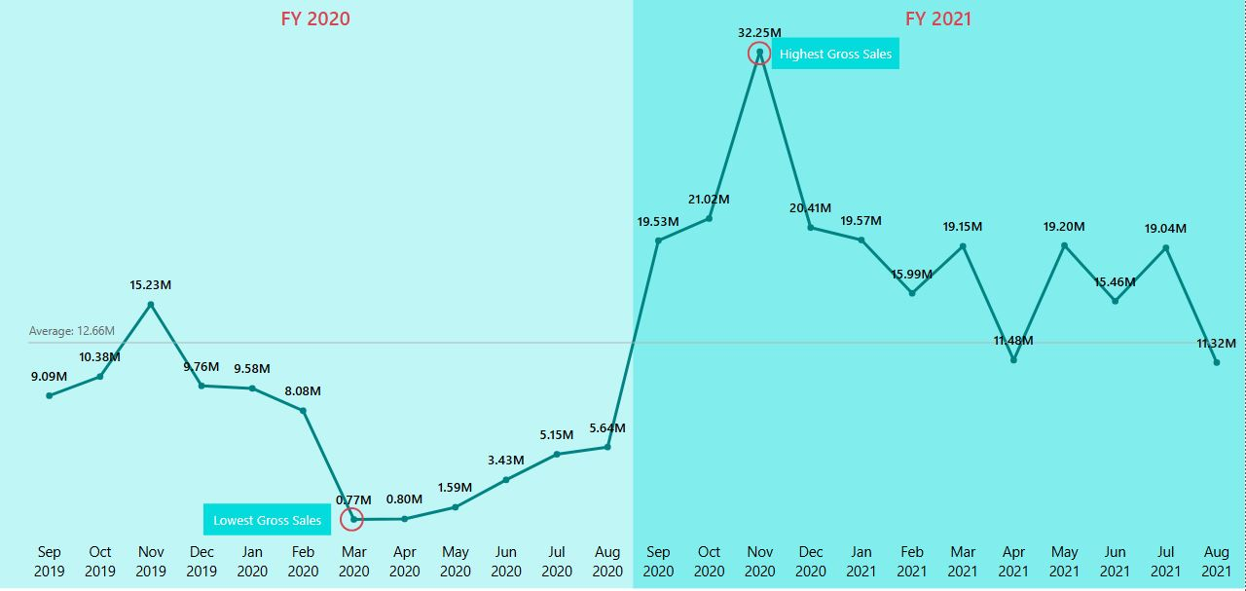
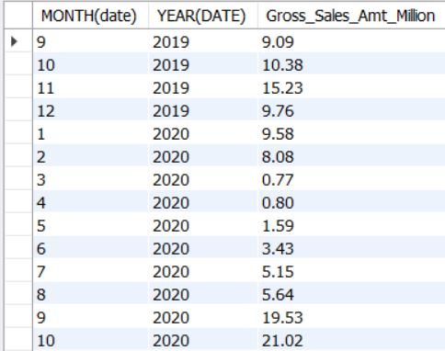
SQL Result Grid
Monthly Gross Sales for "Atliq Exclusive"
Business Question: 7
Generate a report showing the top 5 customers in the indian market who received the highest average pre-invoice discount percentage during fiscal year 2021.
Output fields: customer_code, customer, average_discount_percentage
Unique Product Counts for each Segment

Slide 18
Insights:
Highest Sales: November 2020 – ₹32.25M
Lowest Sales: March 2020 – ₹0.77M
Average Sales: Around ₹12.66M
Sharp decline observed between March and August 2020
Steady recovery post-August 2020, peaking in Nov 2020
FY 2021 showed stable performance between ₹11M–₹20M, post-recovery
COVID-19 pandemic:
Demand suppression (Mar–Jul 2020)
Retail closures, distribution halts
Global Chip Shortage:
Affected electronic and appliance supply in mid-2020
May have contributed to inventory backlog and pent-up demand, released in Q4 2020
Consumer Behaviour Shift:
Increased buying during online sales and unlock phases
Rising preference for home-use gadgets and appliances

Slide 19
Recommendations
Plan inventory and sourcing to absorb future disruptions
Strengthen supply chain to reduce component dependency (e.g., chips)
Use Q1 trends (Sep–Nov) for annual sales push
Develop early warning systems using sales + global supply data

Slide 20
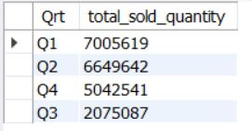
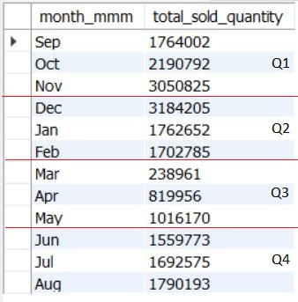
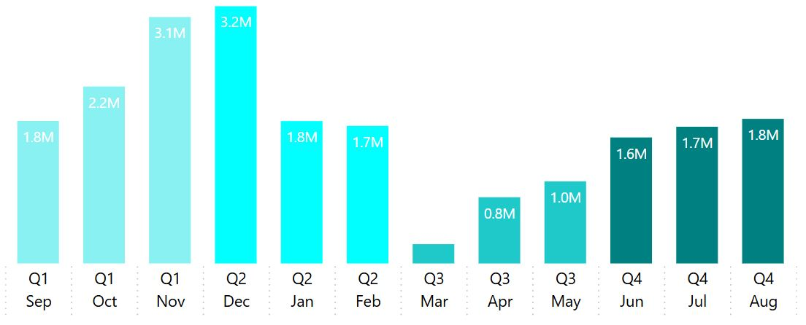
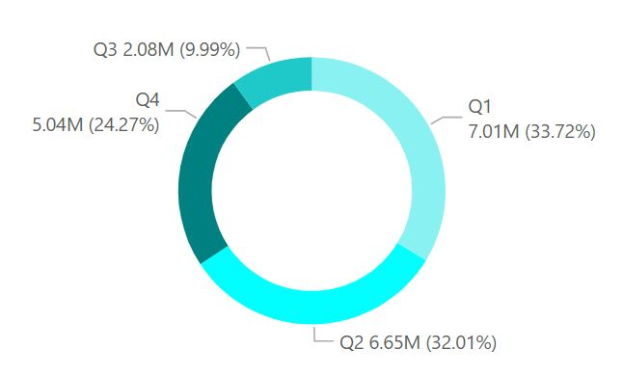
SQL Result Grid
Quarter with Maximum Total Sold Quantity – 2020
Business Question: 8
In which quarter of 2020, got the maximum total_sold_quantity? The final output contains these fields sorted by the total_sold_quantity: Quarter, total_sold_quantity
Unique Product Counts for each Segment

Slide 21
Insights: Overall Trend:
Q1 (Sep–Nov): Highest sales – 7.01M units (≈34% of total FY sales)
Q3 (Mar–May): Lowest sales – 2.08M units (≈10%)
December (Q2) had peak monthly sales – 3.2M units
March (Q3) recorded lowest monthly sales – 0.8M units
Interpretation & Cause Analysis
Q3 dip aligns with COVID-19 peak lockdown (Mar–May 2020) → Manufacturing & logistics disruptions → Supply shortages & drop in B2B demand
Early recovery in Q4 (Jun–Aug) despite ongoing pandemic → Surge in remote learning and WFH setups → Spike in demand for laptops, webcams, headsets, and peripherals
Q1 surge likely influenced by: → Pre-festive stocking → Normal retail cycles prior to pandemic disruption
Recommendations:
Pre-stock inventory before Q1 & Q4 demand peaks
Strengthen digital sales & last-mile delivery
Build scenario-based planning for crisis resilience
Promote key products aligned with remote/online use cases

Slide 22
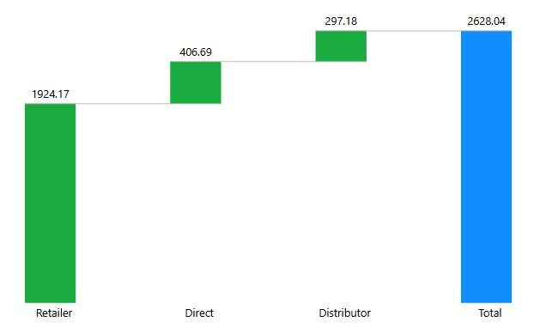
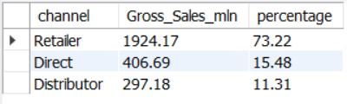
SQL Result Grid
Top Revenue-Contributing Channel – FY 2021
Business Question: 9
Which channel helped to bring more gross sales in the fiscal year 2021 and the percentage of contribution? The final output contains these fields: Channel, Gross_sales_mln, Percentage
11.31%
15.48%
73.22 %
Insights:
Retailer channel generated the highest gross sales: ₹1924.17M (≈ 73.22% of total sales).
Direct sales contributed ₹406.69M (15.48%).
Distributor channel had the lowest contribution: ₹297.18M (11.31%).
Unique Product Counts for each Segment

Slide 23
Insights & Interpretation:
Retailer channel dominates – contributing nearly 3/4th of total sales.
Direct channel, though secondary, still plays a significant role (15.48%) – potential for growth via strategic push.
Distributor channel lags – lowest contribution (11.31%), possibly due to limited reach, outdated models, or ineffective partnerships.
Recommendations:
Double down on retailer network efficiency – invest in CRM, POS tech, or incentive programs.
Explore D2C (Direct-to-Customer) strategies – improve margins and personalization.
Re-evaluate distribution strategy – restructure partner incentives or explore new geographies.

Slide 24
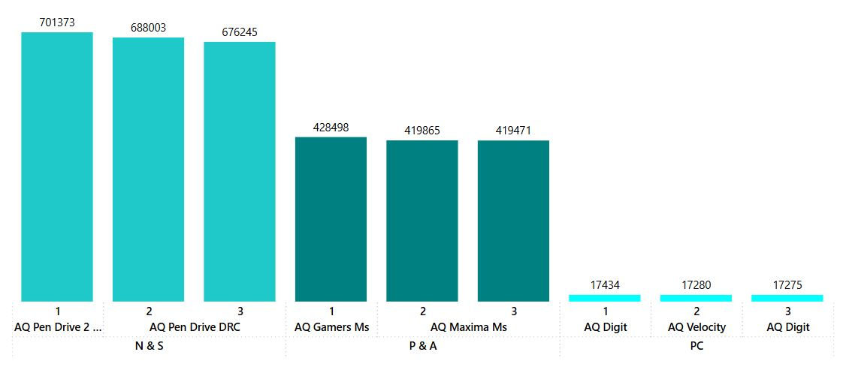
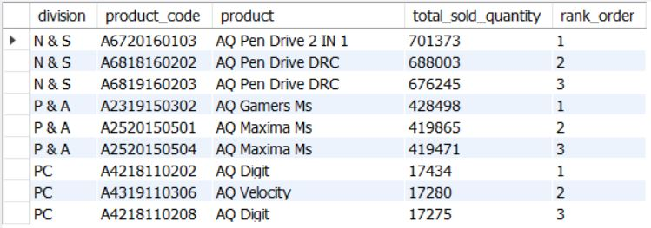
Top 3 High-Selling Products by Division – FY 2021
Business Question: 10
Get the top 3 products in each division that have a high total_sold_quantity in the fiscal year 2021.
The final output contains these fields: division, product_code
SQL Result Grid
Unique Product Counts for each Segment

Slide 25
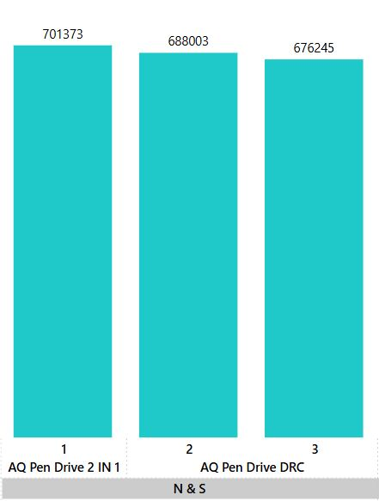
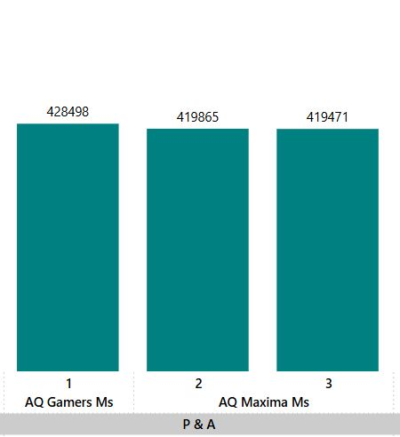
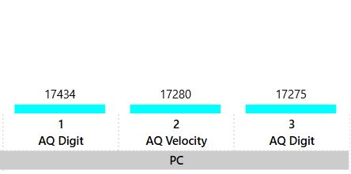
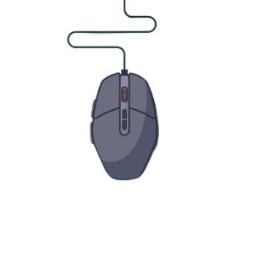


N & S Division (Pen Drives)
All top 3 products are variants of AQ Pen Drives, collectively contributing over 2 million units:
AQ Pen Drive 2 IN 1: 701,373 units
AQ Pen Drive DRC (2 variants): 688,003 + 676,245 = 1,364,248 units
Pen drives are dominant in this division, indicating a strong market demand for portable storage solutions.
P & A Division (Mouse)
All top 3 products are mouse variants:
AQ Gamers Ms: 428,498 units
AQ Maxima Ms (2 variants): 419,865 + 419,471 = 839,336 units
High sales suggest consistent consumer preference for performance and ergonomic mouse.
PC Division (Personal Laptops)
All top 3 products are laptop variants:
AQ Diqit (2 variants): 17,434 + 17,275 = 34,709 units
AQ Velocity: 17,280 units
Laptop sales volume is relatively much lower, which may point to higher price points, longer purchase cycles, or market saturation.

Slide 26


Key Takeaways
Volume vs. Value:
Pen Drives (N & S): High volume, likely low-cost, high-demand items.
Mice (P & A): Moderate volume, possibly mid-range pricing.
Laptops (PC): Low volume, possibly high-value products.
Strategic Recommendations:
For N & S: Continue innovating pen drive variants (e.g., security features, faster speeds).
For P & A: Expand into related accessories (gaming keyboards, pads).
For PC: Investigate if sales are low due to price, lack of awareness, or product features—consider bundling or educational campaigns.

Slide 27
THANK YOU !

Slide 28
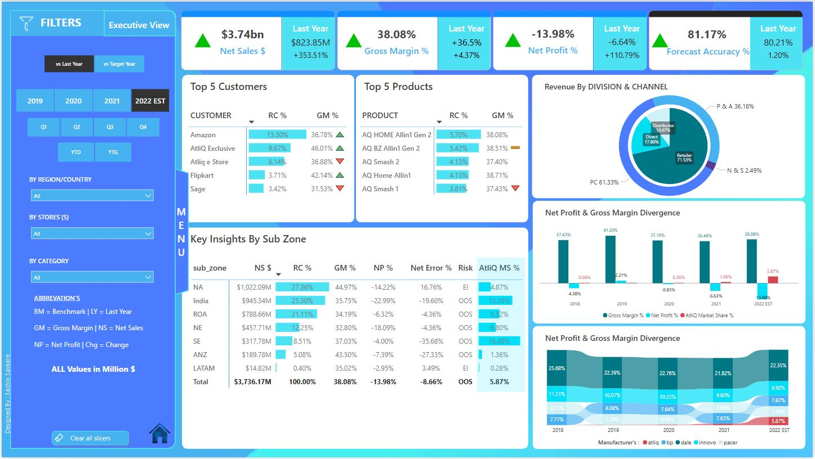
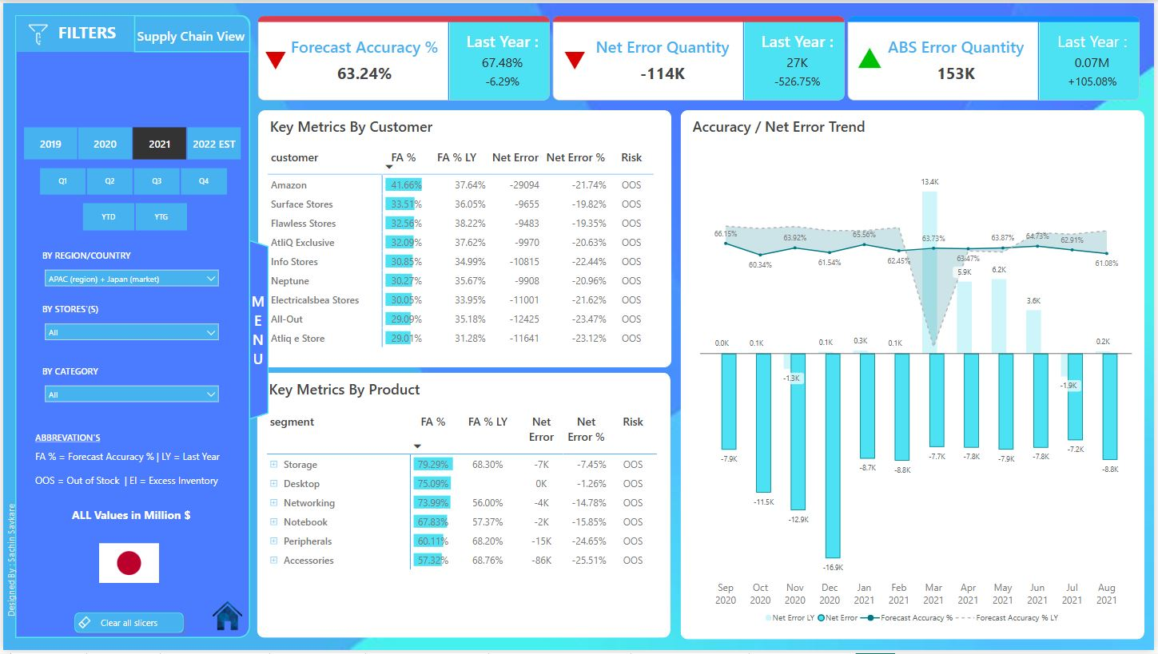



Business Insights 360 | Power BI Dashboard Driving Smarter Decisions Across Finance, Sales, Marketing, Supply Chain & Executive Views

Slide 29



Unlocking Hospitality Growth: Power BI Insights Driving Revenue & Strategy for AtliQ Grands

Slide 30

Customer Experience Analytics | Power BI Dashboard for Operational Insights

Slide 31

Consumer Goods | Superstore Analysis: Turning Data into Decisions with Power BI

